Slide 1
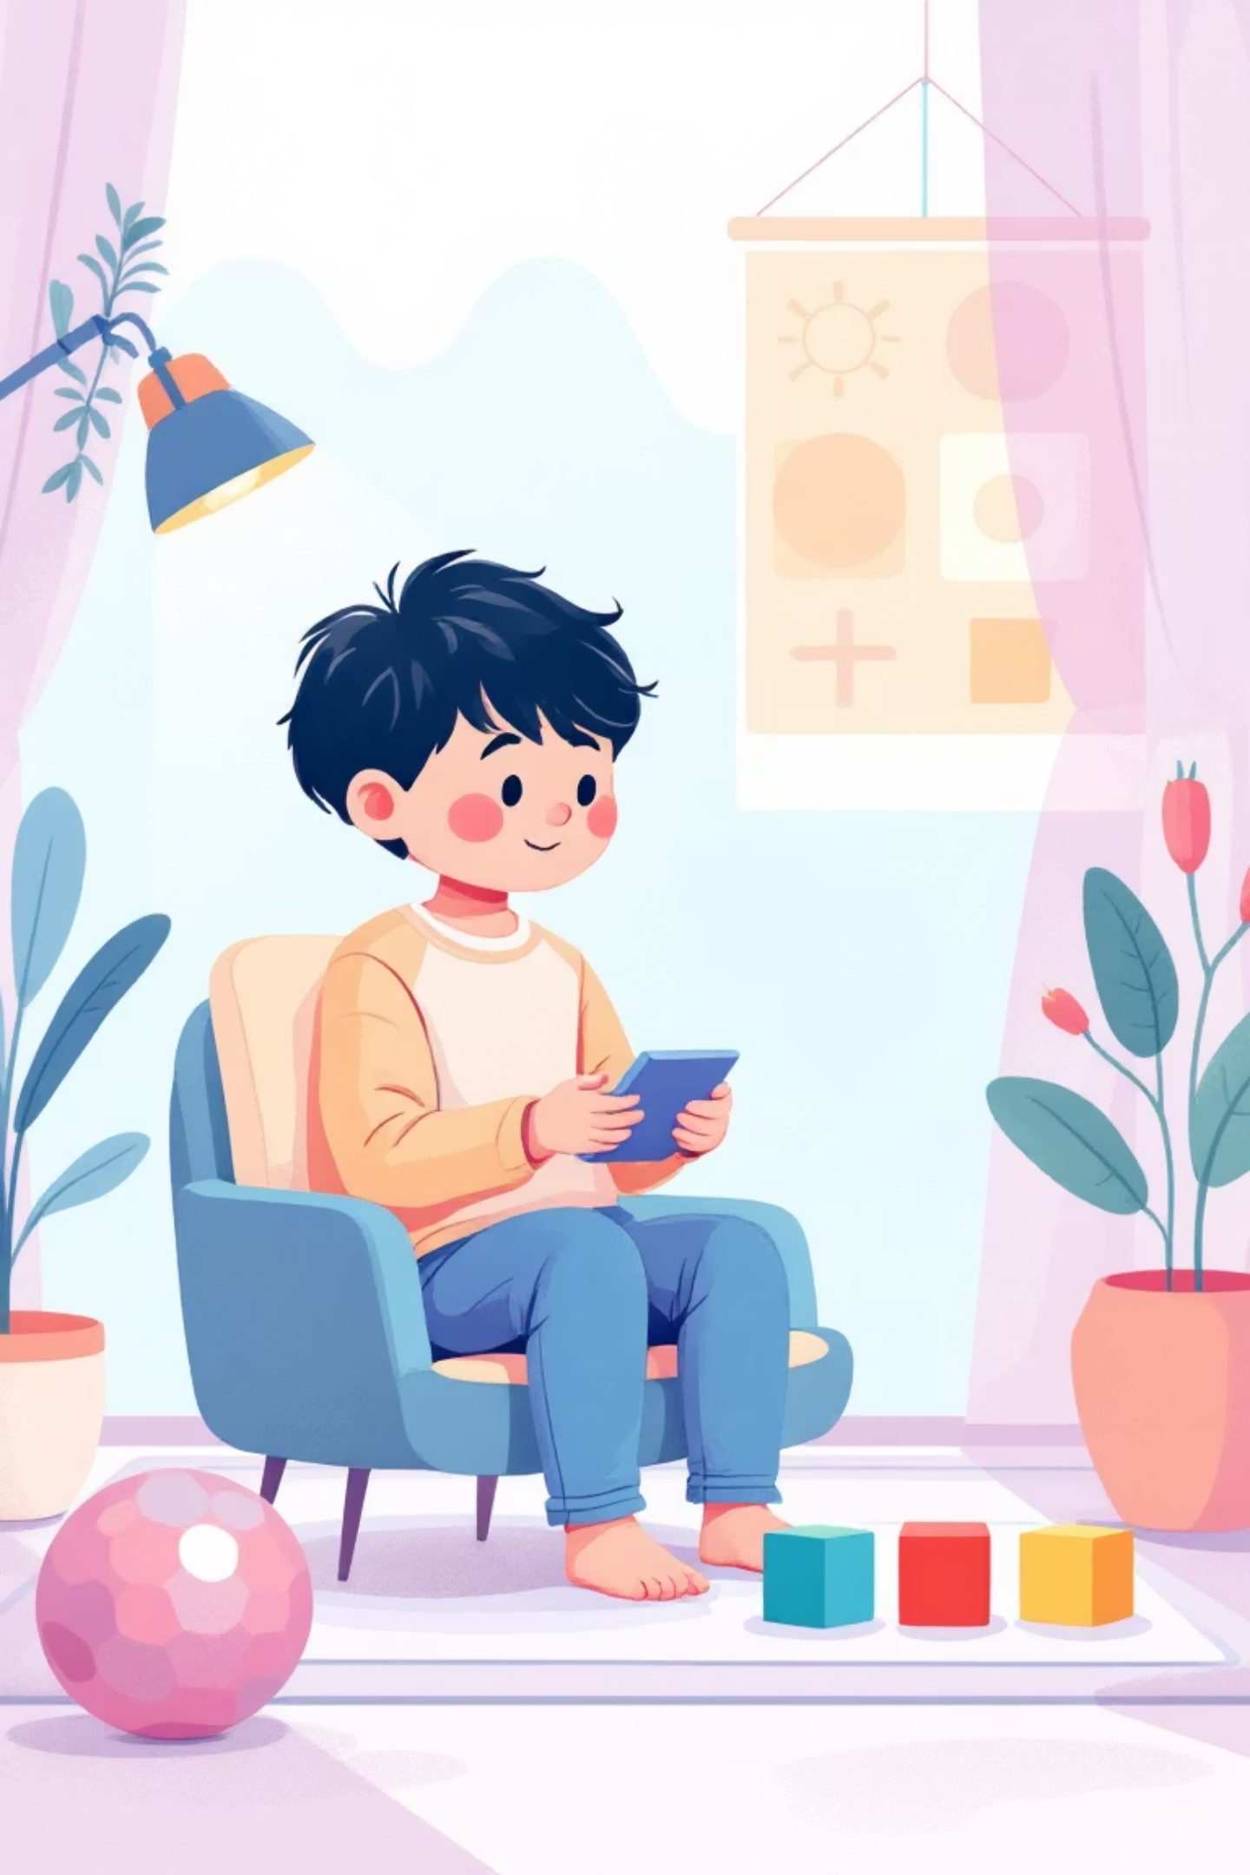

VISION THERAPY IN AUTISM
BY :- TANYA NEGI

Slide 2

INTRODUCTION
Vision Therapy for children with Autism Spectrum Disorder (ASD) is a specialized treatment aimed at improving fundamental visual skills. These include Eye Coordination, Focusing abilities, and Visual Processing. The therapy involves a series of personalized exercises, often encompassing Eye Tracking, Focus Tasks, and Visual-Motor Activities.
This non-surgical approach effectively addresses numerous visual issues, such as crossed or lazy eye (amblyopia), eye turns (strabismus), and convergence insufficiency. It also helps manage visual-seeking behaviors in children, where they closely examine objects or stare intensely to understand visual details.
As our understanding of autism deepens, vision therapy is increasingly recognized as a crucial supportive intervention. It significantly contributes to enhanced learning outcomes, better sensory balance, and improved quality of life for individuals with ASD.

Slide 3

Role of Vision Therapy in Autism
Vision therapy serves a critical supportive and developmental function in addressing the visual processing challenges prevalent among children with Autism Spectrum Disorder (ASD). Many children with autism often experience difficulties not with their eyesight itself, but rather with how their brain interprets and organizes visual information.

Slide 4

The primary goal of vision therapy is to enhance eye coordination, visual tracking, attention, and the child's ability to engage meaningfully with their visual environment. By strengthening these visual skills, therapy directly contributes to:
Improved learning capabilities
Better communication skills
Reduced sensory overload
Improved behavior, by alleviating frustration stemming from visual confusion

Slide 5

Who Vision Therapy Helps?
Vision therapy offers significant benefits for children with autism who exhibit specific visual and behavioral challenges:
Difficulty maintaining eye contact
Frequent tripping or bumping into objects due to poor depth perception
Poor hand-eye coordination
Challenges in reading or copying from a board
Problems with visual attention and focus
Trouble following moving objects (e.g., a ball)
Repetitive visual behaviors (e.g., staring at lights, side glancing)
Sensitivity to light or tendency to look away from visual stimuli
This therapy is valuable for both non-verbal and verbal children, especially when integrated with other interventions such as occupational therapy, Applied Behavioral Analysis (ABA), or speech therapy, creating a holistic support system.

Slide 6

Hyper (Over-sensitivity) | Hypo (Under-sensitivity)
Focusing on tiny pieces of dust/particles. | Attracted towards light.
Aversion to dark and bright light. | Looking intensely at objects or people.
Dislike of sharp flashes of light. | Moving fingers or objects in front of the eyes.
Looking down most of the time. | Fascination in objects that reflect light or are highly coloured.
Covering/closing eyes at bright lights.

Slide 7





Vision Exercise Program for Children with Autism
A typical structured vision therapy program involves 20–40 minute sessions, conducted once or twice a week. These programs are carefully designed and tailored to each child's unique needs.
Eye Tracking Exercises
Eye Coordination & Alignment
Visual Attention Training
Activities like following a moving light or object with the eyes, and smooth pursuit and rapid eye movement tasks.
Training using stereograms or prism lenses to improve fusion and convergence.
Focus-shift activities, such as repeatedly shifting focus between near and far objects.
Balance & Spatial Awareness
Hand-Eye Coordination
Tasks like walking on a balance beam while visually tracking objects.
Engaging games like catching, throwing, and target hitting.
Each program is carefully customized to suit the child's sensory tolerance levels and individual learning pace, ensuring maximum effectiveness and comfort.

Slide 8
Activities to Improve :
Visual Perception and Eye Contact
These engaging activities are often integrated into home routines or therapy sessions, making learning both effective and enjoyable.
Face Tracking Games
Puzzles and Shape Matching
Using toys near the therapist's eyes to encourage eye contact and
social engagement.
Activities that enhance visual discrimination, pattern recognition, and problem-solving skills.
Object Search Activities
Mirror Play
Games like "find the hidden toy" that improve visual scanning and
attention to detail.
Encourages self-awareness, facial recognition, and understanding of expressions.
Bubble Tracking
Sorting and Color-Matching
Improves visual tracking skills and motivates looking in different directions (upward/downward).
Strengthens visual categorization, recognition patterns, and cognitive organization.
These enjoyable activities skillfully combine therapeutic objectives with play, significantly boosting the
effectiveness of learning and development.

Slide 9

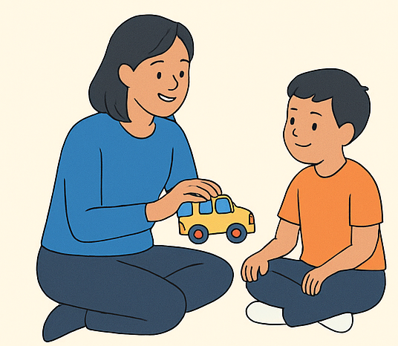
WHO DOES VISION THERAPY AND FOR HOW LONG?
Vision therapy helps improve visual skills and is provided by professionals like occupational therapists, physiotherapists, or optometrists.
For children, the therapy should be kept to short sessions to prevent overstimulation. It is recommended to keep sessions once or twice a day, five days a week. Starting gradually helps children stay comfortable and benefit more from the therapy.

Slide 10
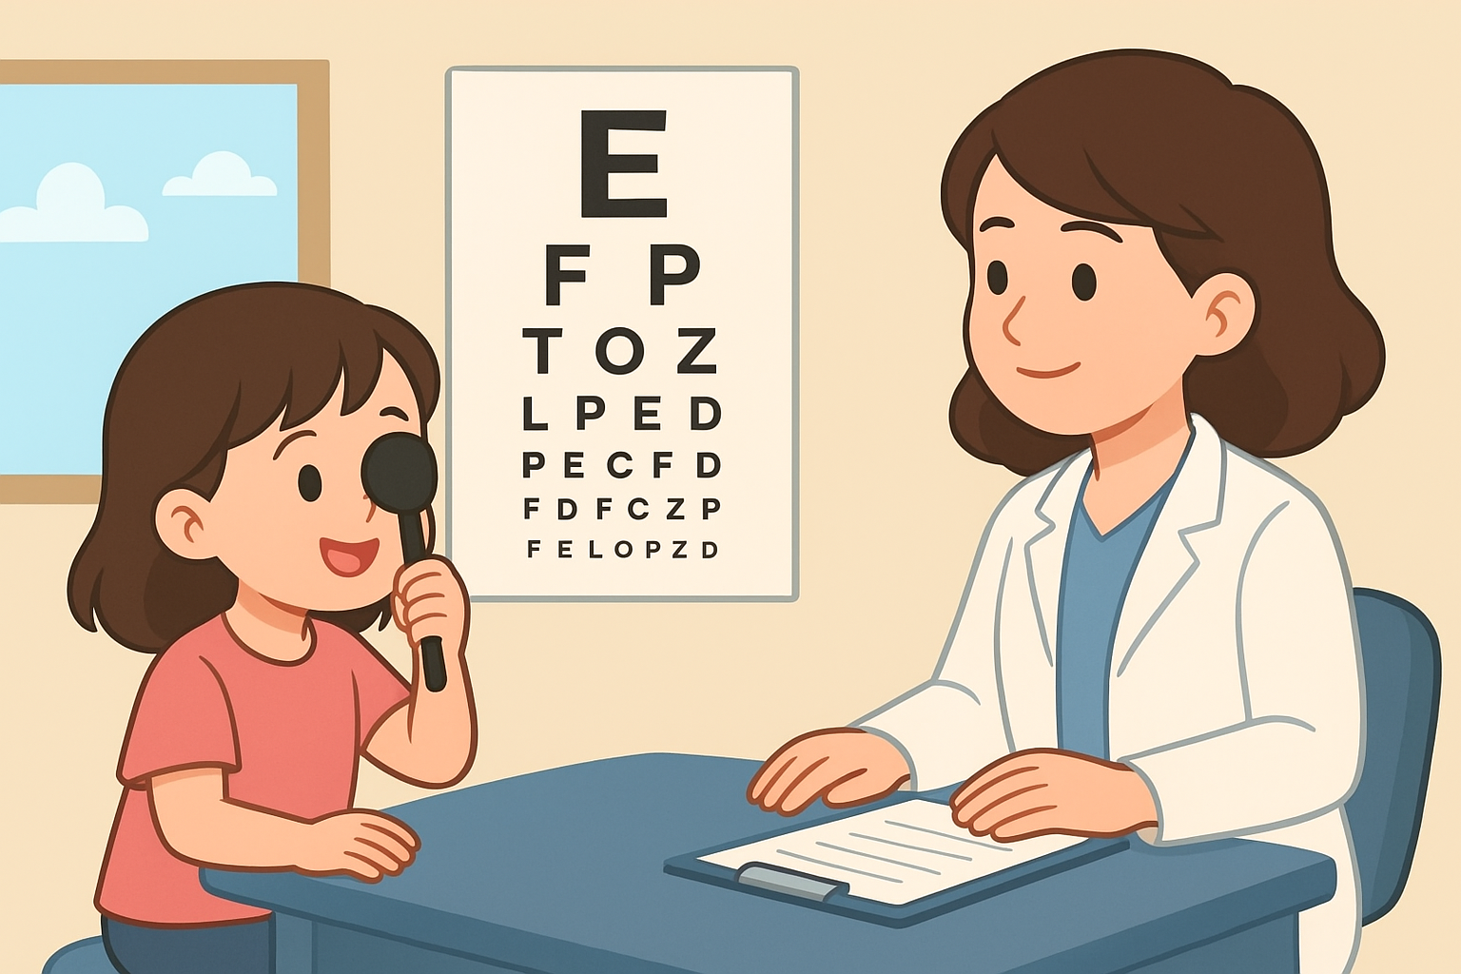

Slide 11

Safety and Benefits of Vision Therapy in Children with Autism
Safety Considerations
Vision therapy is widely considered safe and non-invasive.
All exercises are performed under the direct supervision of trained professionals.
The intensity and duration of therapy sessions are carefully adjusted based on the child's sensory tolerance and individual needs.
Parents receive comprehensive education on implementing safe and effective home-based activities without causing over-stimulation.
Regular breaks are incorporated into sessions to prevent stress or visual fatigue, ensuring a positive therapeutic experience.

Slide 12
Additional Safety Considerations for Vision Therapy
Therapy begins with a sensory profile assessment to ensure activities match the child’s comfort level and visual processing abilities.
Tools and materials used in therapy are child-safe, non-toxic, and designed to avoid visual strain or glare.
Therapists monitor behavioral cues (like rubbing eyes, fidgeting, increased stimming) to pause or modify activities immediately.
Sessions gradually progress from simple to complex to prevent cognitive overload and frustration.
Lighting and environment are controlled to avoid overstimulation from bright lights, noise, or clutter.
Children are never forced to maintain eye contact, ensuring emotional safety and reducing stress.
Emergency protocols are in place in case the child experiences sensory overload or discomfort.
Activities involving equipment (balls, trackers, mirrors) are introduced only after ensuring the child understands how to use them safely.

Slide 13
BENEFITS
Improved Eye Contact
Better Academic Readiness
Leading to enhanced social engagement and interaction.
Enhancing reading readiness and overall academic performance.
Reduced Visual Stress
Enhanced Motor Coordination
Minimizing sensory overload and promoting a calmer state.
Improving body awareness and physical agility.
Increased Confidence
Better Communication
Empowering children in their daily tasks and interactions.
Strengthening the ability to use and interpret visual cues.
Early intervention in vision therapy typically yields stronger results, seamlessly integrating visual skills with learning and communication development.

Slide 14
CONCLUSION
Vision therapy plays a profound and supportive role in optimizing the visual and sensory development of children with Autism Spectrum Disorder. By specifically targeting how the brain processes visual information, this specialized therapy is instrumental in improving critical skills such as eye contact, visual tracking, hand-eye coordination, and overall visual attention. These enhancements not only foster better learning and academic outcomes but also lead to more robust social communication and improved daily functioning.
While vision therapy is not a cure for autism, it stands as a highly valuable intervention that effectively complements other essential therapies like occupational therapy, behavioral therapy, and speech therapy. When initiated early and meticulously tailored to an individual child's unique needs, it can significantly reduce visual stress, boost confidence, and profoundly enhance their overall quality of life. Thus, vision therapy holds immense importance as a safe, child-friendly, and holistic approach, empowering children with autism to better comprehend and engage with the complex world around them.

Slide 15

Source- Looking after Children with Autism (Handbook)

