Slide 1




PRESENTATION
By Tanya Negi

Slide 2

SPEECH DEVELOPMENTAL MILESTONES
AND MAGIC CELEBRATING SMALL WINS IN SPEECH THEREPY
01

Slide 3
WHAT IS SPEECH AND LANGUAGE DEVELOPMENTAL MILESTONES?
Speech developmental milestones are part of typical language development and refer specifically to the progression of a child’s spoken language skills—how they use their voice to communicate, form sounds, words, and eventually full sentences.
02

Slide 4
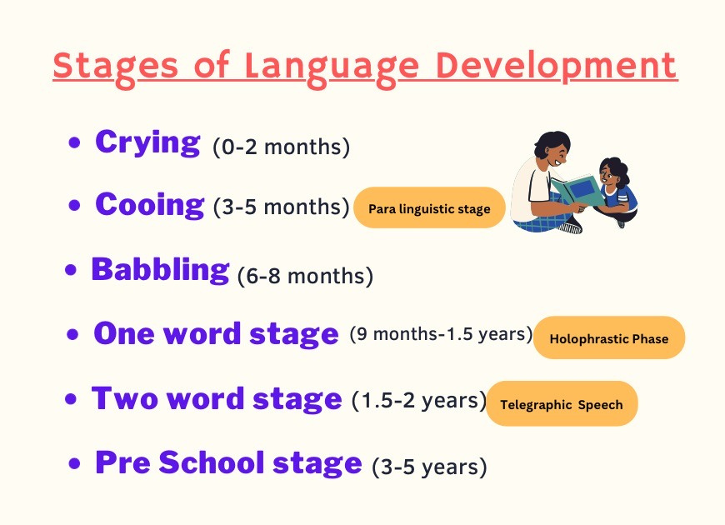
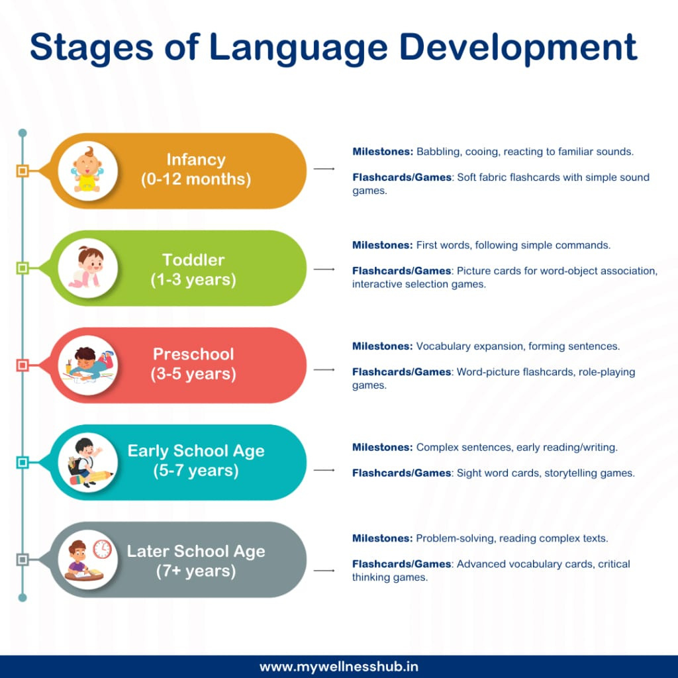
03

Slide 5
BIRTH – 3 MONTHS: EARLY COMMUNICATION BEGINNINGS
Milestones:
Crying is the primary form of communication.
Coos and gurgling sounds emerge, especially when content.
Smiles socially (around 6–8 weeks) in response to voices or faces.
Turns head toward sounds, especially familiar voices.
Begins to show awareness of speaker's tone (soothing vs. angry)
04

Slide 6

4 – 6 MONTHS: BABBLING BEGINS
Milestones:
Babbling starts (e.g., "ba", "da", "ma")—repeating consonant-vowel combinations.
Makes different sounds to express emotions like happiness or frustration.
Laughs out loud and shows pleasure in social interactions.
Turns head toward sound sources; pays attention to music and voices.
Begins to imitate sounds and facial expressions.
05

Slide 7
6 – 12 MONTHS: FIRST WORDS & UNDERSTANDING BEGIN
Milestones:
Babbling becomes varied and complex (e.g., “da-da-da,” “ba-goo”).
Begins to use gestures like pointing, waving “bye-bye.”
Understands common words (e.g., “no,” “bye,” own name).
Responds to simple verbal requests and tone of voice.
May say first intentional words (often “mama,” “dada” around 10–12 months).
Looks at objects or people when named.
06

Slide 8
12 – 18 MONTHS: FIRST WORDS TAKE OFF
Milestones:
Uses 5 to 20 words, primarily nouns (e.g., “ball,” “dog,” “mama”).
Understands simple instructions like “come here” or “give me.”
Points to body parts or familiar objects when named.
Imitates words and sounds heard from adults.
Begins to use single words to express wants and needs (e.g., “milk,” “up”).
07

Slide 9
18 – 24 MONTHS: WORD COMBINATIONS EMERGE
Milestones:
Vocabulary grows to 50+ words by age 2.
Begins to combine two words (e.g., “more juice,” “mama go”).
Names pictures in books and points to objects when asked.
Understands simple questions and commands (e.g., “Where is your shoe?”).
Starts to use pronouns like “me” or “mine.”
08

Slide 10
2 – 3 YEARS: RAPID LANGUAGE EXPANSION
Milestones:
Uses 2–3 word phrases, progressing to simple sentences.
Vocabulary expands to 200–300 words by age 3.
Speech becomes clearer; familiar adults understand most of it.
Begins using plurals, prepositions (in, on), and question words (what, where).
Follows two-step directions (e.g., “Get your shoes and sit down”).
Enjoys naming and describing things in books and surroundings.
09

Slide 11
3 – 4 YEARS: COMPLEX SENTENCES AND CLEARER SPEECH
Milestones:
Uses 4–5 word sentences to express thoughts and describe events.
Speech is mostly understood by unfamiliar listeners.
Begins to use correct grammar, including past tense (“played”) and plurals (“cats”).
Asks many “why,” “who,” and “how” questions.
Follows multi-step directions (e.g., “Pick up the toy, put it in the box, and come to me”).
Tells short stories and can stay on topic in conversations.
10

Slide 12
IMPORTANCE OF CELEBRATING SMALL WINS IN SPEECH THERAPY
Why Small Wins Matter:
Builds confidence in children and reinforces effort.
Encourages a positive emotional connection to communication.
Helps maintain motivation for long-term therapy goals.
Supports a growth mindset—valuing progress over perfection.
11

Slide 13
STRATEGIES FOR CELEBRATING SMALL WINS
1. Visual Reinforcement:
Use sticker charts, star boards, or reward jars to track accomplishments.
Create a “Wall of Wins” to showcase achievements.
2. Verbal Encouragement:
Offer immediate, specific praise: “You said ‘ball’ so clearly—well done!”
Use positive tone and facial expressions to boost engagement.
3. Play-Based Rewards:
Offer a short preferred activity (e.g., bubbles, favorite toy) after effortful tasks.
Use fun sounds or puppets to celebrate success in sessions.
4. Family Involvement:
Share small wins with parents to reinforce success at home.
Encourage families to celebrate progress with routine praise and attention.
5. Visual Progress Tools:
Keep a progress folder with pictures, crafts, or goal trackers.
Show before-and-after examples of speech improvements.
6. Celebrate Consistency, Not Just Achievement:
Praise trying, not just getting it right: “You’re working so hard today!”
Reinforce the effort and participation, not only outcomes.
12

Slide 14
4. Family Involvement:
Share small wins with parents to reinforce success at home.
Encourage families to celebrate progress with routine praise and attention.
5. Visual Progress Tools:
Keep a progress folder with pictures, crafts, or goal trackers.
Show before-and-after examples of speech improvements.
6. Celebrate Consistency, Not Just Achievement:
Praise trying, not just getting it right: “You’re working so hard today!”
Reinforce the effort and participation, not only outcomes.
13

Slide 15
EXAMPLES OF SMALL WINS IN SPEECH THERAPY
Sound Production:
Attempting a difficult sound for the first time (e.g., “s” or “r”).
Moving from approximation to clearer articulation (e.g., “wabbit” to “rabbit”).
Language Use:
Using a new word in conversation.
Combining two or more words for the first time (e.g., “want toy”).
Correctly answering a “wh” question.
14

Slide 16
Social Communication:
Making eye contact during interaction.
Initiating conversation with a peer or adult.
Taking turns in a structured activity.
Listening & Comprehension:
Following a two-step direction independently.
Pointing to the correct picture in response to a word.
Recognizing and labeling familiar objects.
Fluency & Voice:
Speaking smoothly during a full sentence.
Using a calm voice in a structured setting.
Celebration Tip:
Even a smile, a longer attention span, or sitting for the full session can be a huge win for some children!
15

Slide 17
Celebration Tip:
Even a smile, a longer attention span, or sitting for the full session can be a huge win for some children!
16

Slide 18
CONCLUSION: NURTURING GROWTH THROUGH MILESTONES AND MOTIVATION
Speech and language development is a journey marked by steady growth and unique challenges.
Recognizing and supporting developmental milestones helps guide effective intervention.
Celebrating small wins empowers children, boosts confidence, and keeps therapy engaging and joyful.
Speech therapy is not only about reaching big goals—it’s about valuing every step along the way.
Final Thought:
Each word spoken, gesture made, or sound attempted is a victory worth celebrating. Let’s honor progress and keep the joy of communication alive!
17

Slide 19
THANK YOU
18

